Slide 1
ENDOSCOPIC BARIATRIC SURGERY
Maria valeria matteo, md, phd
Fondazione policlinico universitario a. gemelli irccs

Slide 2
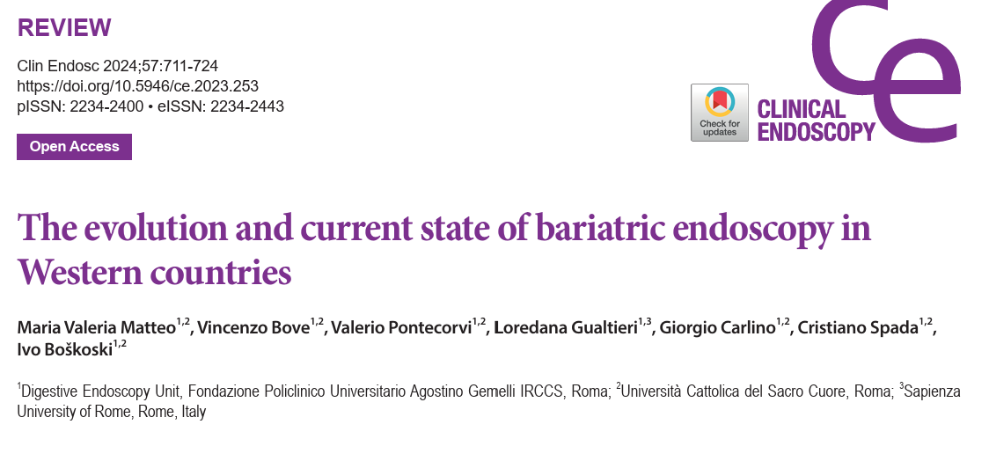

Slide 3
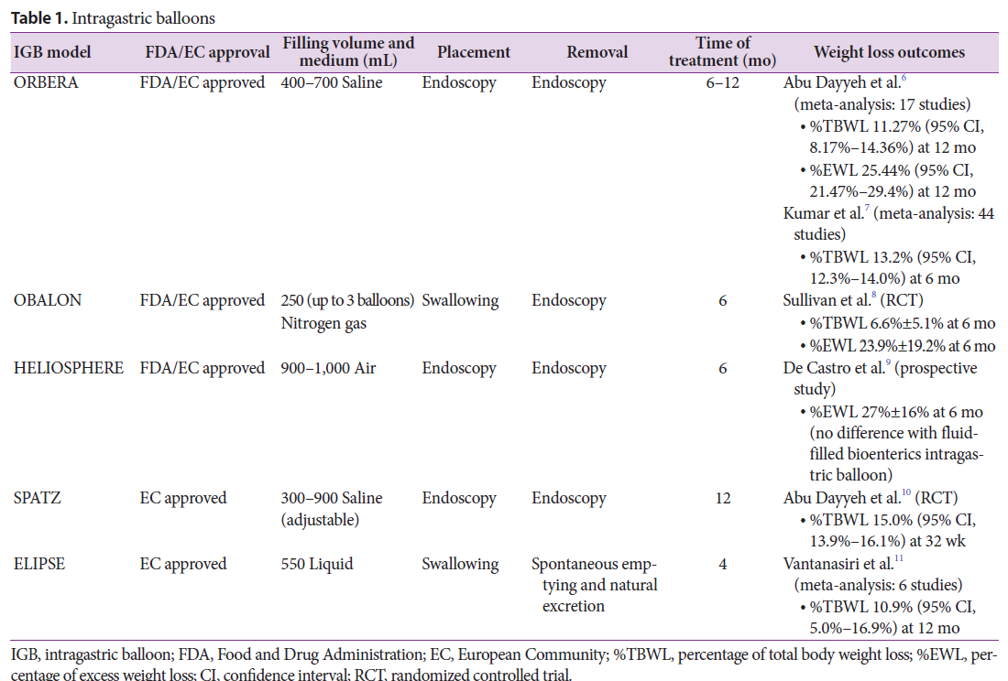
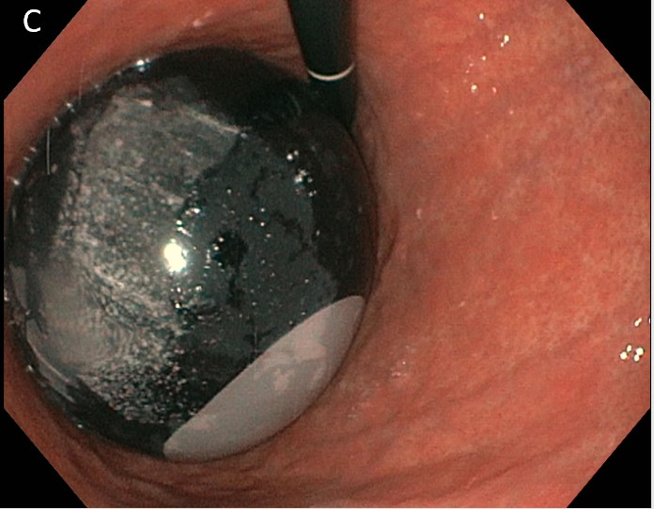
INTRAGASTRIC BALLOONS
First described in 1982
Mechanism: satiety induced by reducing the gastric volume, similar to an artificial bezoar, and by modifying stomach emptying
IGB placement is temporary (4-12 mo), no permanent anatomical changes

Slide 4
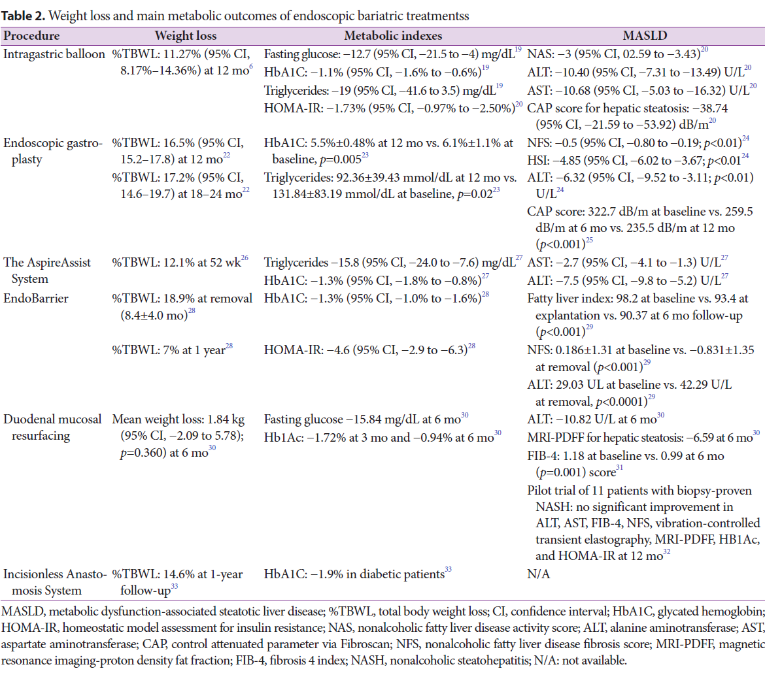
IGB: Efficacy data
Long-term data (scarce) of IGB use show a trend toward weight regain over time.
A cohort of 49 patients included in an RCT (6-month IGB vs. sibutramine) followed up for 10 years showed weight regain in both groups, although the IGB cohort had an advantage compared to the control group at 5 years (–0.21 vs. 5.34 kg, p<0.01) and 10 years (–2.32 vs. 0.03 kg, p=0.05).

Slide 5
IGB: Adverse Events
Maladaptive symptoms (such as nausea, vomiting, and epigastric pain)
Early removal 7%
Esophageal/gastric mucosal damage
Perforation
Gastrointestinal obstruction related to self-disinflation and migration (*↑dwelling time)
Spontaneous intragastric balloon hyperinflation*
Mortality (rare)
SAEs : 5.2% to 10.5%

Slide 6
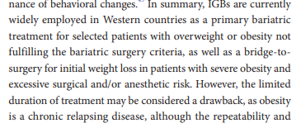
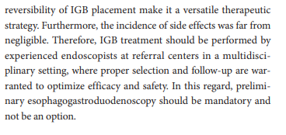
INTRAGASTRIC BALLOONS

Slide 7
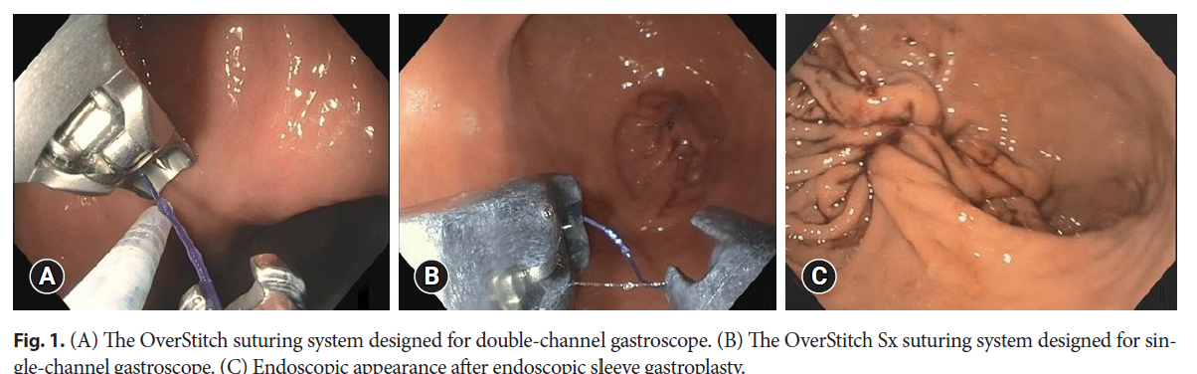
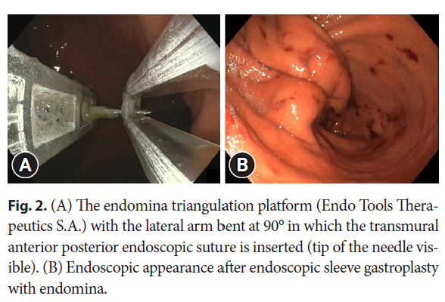
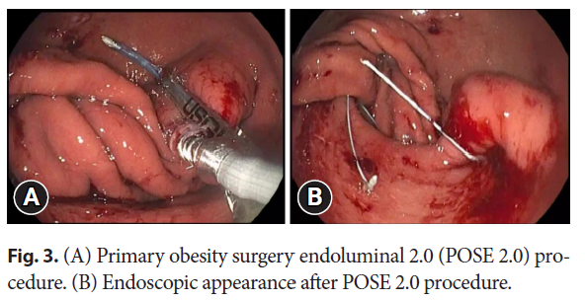
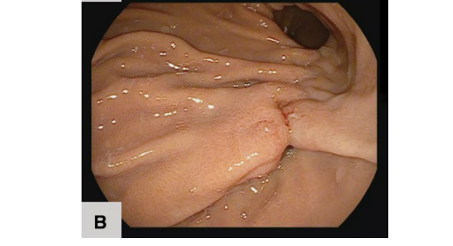
GASTRIC REMODELING TECHNIQUES
These techniques (various suturing devices) consist of full-thickness suturing of the gastric body (organ-sparing, scarless, reversible).
Mechanisms: volume restriction and delayed gastric emptying
Endozip

Slide 8
EGR: Efficacy data
Overstitch
Endomina
RCT (ESG vs LSM): %EWL of 38.6% (Endomina group) Vs 13.4% (control group), p<0.001
%EWL and %TBWL of 41.3% and 11.9%, respectively, at the 1-year follow-up
POSE 2.0
% TBWL: 15.7% ± 6.8 at 12 mo, % TBWL: 12.2% ± 9.6 at 24 mo
HbA1C 6.5% ± 1.4% to 5.7% ± 0.8%) at 6 mo p=0.04
CAP score -88.8 dB/m (95 %CI; -110.2, -67.3) at 12 mo, p<0.001

Slide 9
EGR: Safety
SAEs : 1.1-2.2%
Pain and nausea requiring hospitalization
Perigastric fluid collection
Bleeding requiring transfusion or endoscopic intervention
Refractory accommodative symptoms requiring ESG reversal
Pneumoperitoneum and pneumothorax
Perforation
Notes:
Most data on overstitch

Slide 10
EGR: Indications
Class I or II obesity who fail conservative weight loss methods
Adolescents with class II obesity who fail conservative weight loss methods
Therapeutic opportunity in patients with class III obesity who refuse surgery as well as poor surgical candidates, such as patients with surgically impenetrable abdomen due to previous surgery, and in patients with BMI ≥50 kg/m² as bridge-to-surgery.
IFSO Guidelines

Slide 11
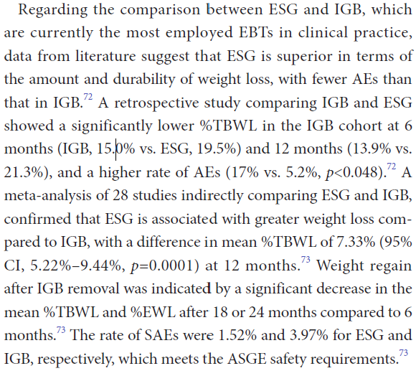
EGR Vs IGB

Slide 12
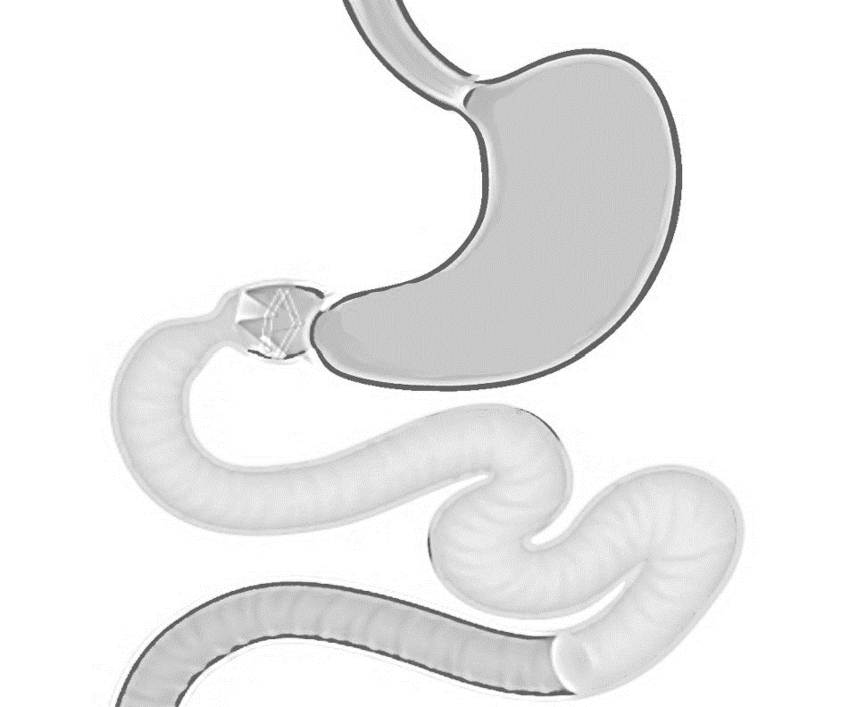
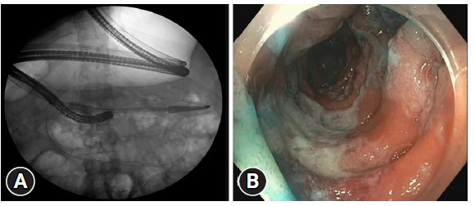

Slide 13
Conclusions
Obesity is a chronic, relapsing, and multifactorial disease requiring multidisciplinary and often multimodal management.
Bariatric endoscopy has gained popularity in recent years as an effective, minimally invasive, and accessible interventional approach.
Restrictive techniques are widely used in clinical practice in Western countries. However, data on long-term outcomes and predictors of success/failure remain limited, and further studies are needed.
Despite the promising results and fascinating nature of the available small intestine-targeted endoscopic bariatric and metabolic therapies, these should be further investigated and understood before being used outside the setting of clinical trials.

Slide 14
Grazie

